Slide 1

Marketing Campaign Performance Analysis
A comprehensive analysis of 2021 marketing campaigns examining reach, engagement, cost efficiency, and ROI across campaign types and locations.
Prepared by: Abena Cica Mireku
Aspiring Data Analyst & Business Intelligence Analyst

Slide 2

Analysis Objectives
Reach Assessment
Engagement Analysis
Evaluate campaign impressions and audience penetration across different channels and locations.
Measure click-through rates and user interaction patterns throughout 2021.
Cost Efficiency
Assess acquisition costs and return on investment across campaign types.

Slide 3
Dataset Structure
Campaign Attributes
Performance Metrics
Campaign type and channel
Impressions and clicks
Target audience segments
Conversion rates
Geographic location data
Acquisition costs
Campaign dates and duration
Return on investment (ROI)
Each row represents an individual marketing campaign with comprehensive performance data for analysis.

Slide 4
Dashboard Overview
The Marketing Performance Dashboard provides a high-level overview of campaign KPIs, time trends, and performance segmented by campaign type and location.

Slide 5
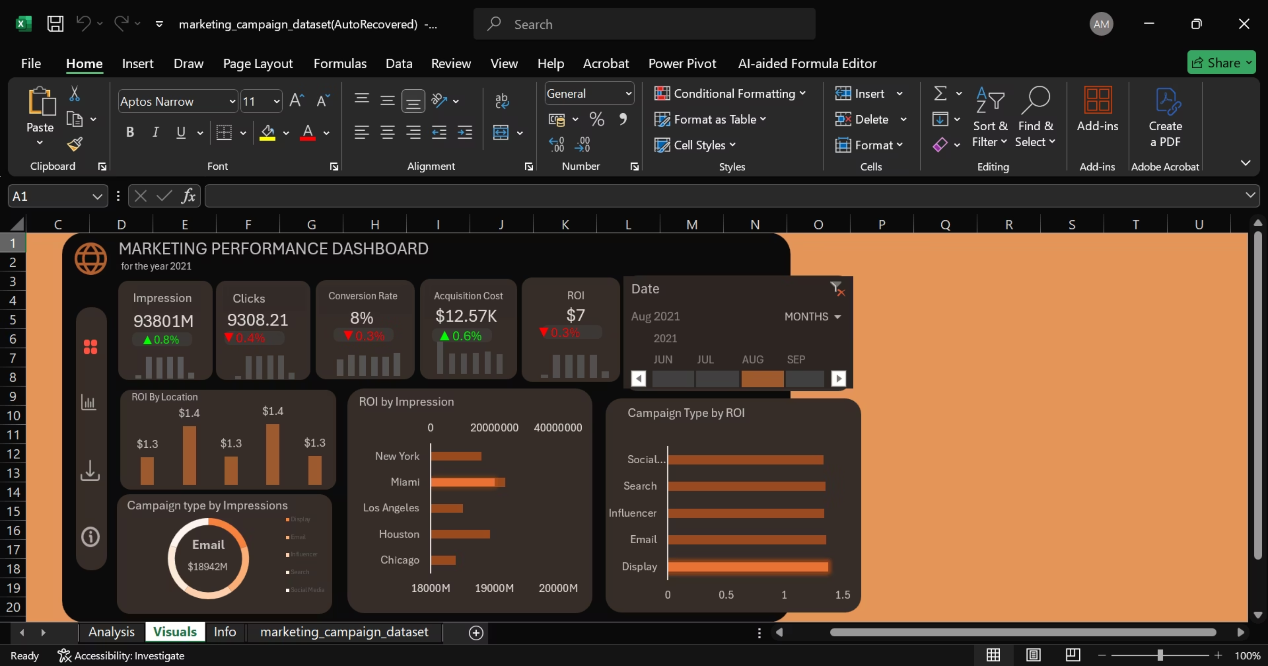

Slide 6
Overall Performance Highlights
1
2
3
Strong Reach
Stable Engagement
Balanced Regional Impact
High impression volumes demonstrate effective audience penetration across all campaign types.
Consistent engagement metrics throughout the year indicate reliable campaign performance.
Performance remains relatively consistent across locations, showing effective regional strategies.

Slide 7
Campaign Type Performance
Email Campaigns
Display Campaigns
Search Campaigns
Contributed the largest share of impressions, demonstrating strong reach and audience engagement.
Demonstrated slightly higher average ROI with effective visual engagement strategies.
Showed strong ROI performance with targeted keyword strategies and intent-based reach.

Slide 8




Key Findings Summary
High Impression Volume
Superior ROI
Regional Balance
Email campaigns led in total reach
Display and Search showed higher returns
Consistent performance across locations
Note: ROI and conversion rate values are pre-calculated in the dataset, limiting revenue-based efficiency calculations.

Slide 9
Analysis Limitations
Pre-Calculated Metrics
Simulated Data
Limited Granularity
ROI and conversion rates are provided in the dataset, limiting the ability to perform custom revenue-based or weighted efficiency calculations.
The dataset is simulated and intended for analytical practice, which may not reflect real-world complexity and variability.
Campaign-level data restricts deeper analysis of individual touchpoints and customer journey insights.

Slide 10

Recommendations for Future Analysis
01
02
Expand Efficiency Metrics
Advanced Segmentation
Incorporate cost per click (CPC), click-through rate (CTR), and cost per thousand impressions (CPM) for comprehensive efficiency analysis.
Utilize Power BI or SQL for deeper segmentation by audience demographics, behavior patterns, and campaign timing.
03
Performance Modeling
Develop predictive models to forecast campaign performance and optimize budget allocation across channels.

Slide 11


Key Takeaways
Strong Foundation
Optimization Opportunities
2021 campaigns achieved solid reach and stable engagement across all channels.
Display and Search campaigns show promise for increased investment based on ROI performance.
Next Steps
Implement advanced analytics tools and expanded metrics for deeper performance insights.

